Slide 1
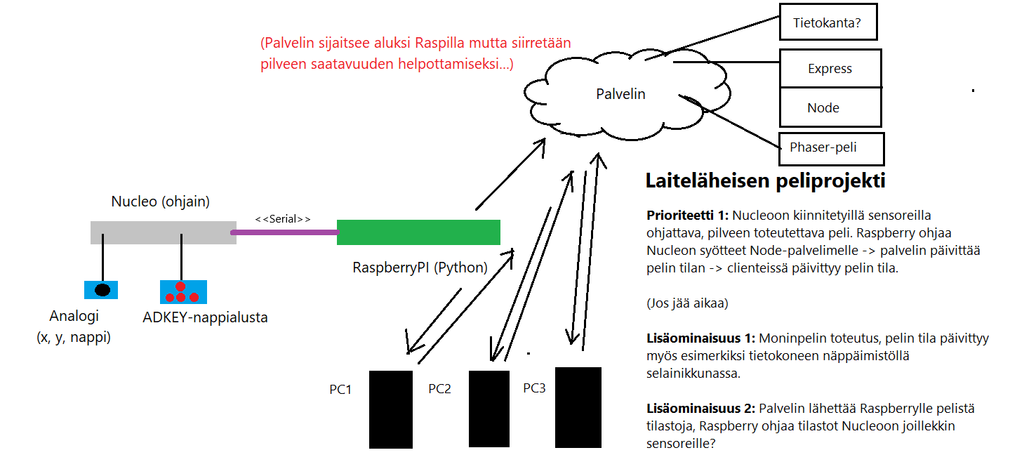
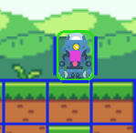
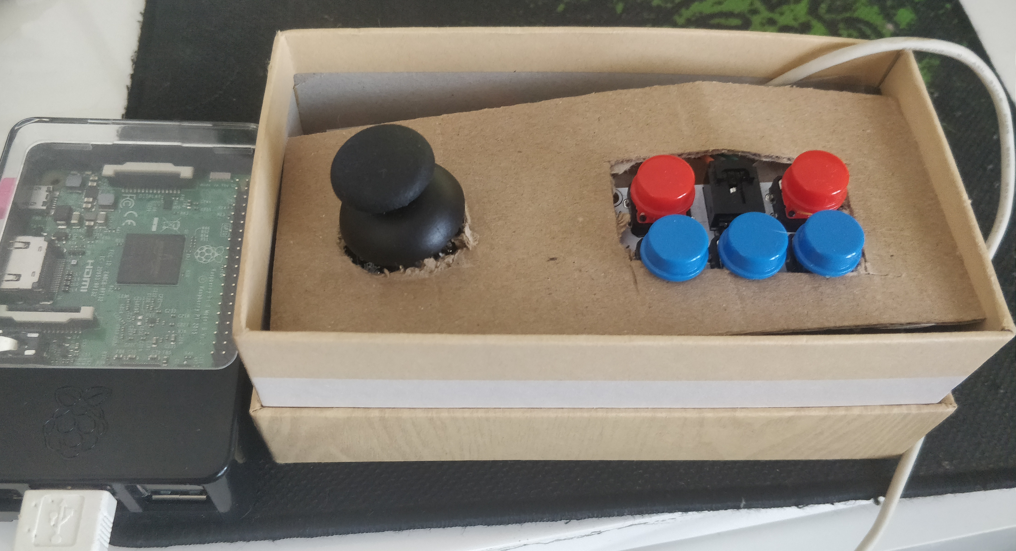
PELI/IOT (GROUP 2)
Jaakko Ikäheimo, Konsta Holm, Arttu Rusanen
Information Technology, Software Development
Introduction
This document is a project poster of TVT19KMO group number 2. The project is a part of the software engineer study plan.
FIGURE 1. The initial plan of the project in Finnish.
Objectives
The project team aimed to develop a controller for Nucleo which would be used by a driver software to control a character in a web-based 2D platformer game. Goals for the game were to achieve semi-realistic physics and to have some basic functionality which could be used by the controller. New objectives for the game developed on the go as the project progressed. The biggest secondary objective achieved was the development process of multiplayer and the associated game server. Many small side-objectives were also added such as intro scene for the game and a spectator mode, which was seen necessary.
Methods
The software for the game was written in JavaScript using Phaser library as the game engine. For the controller the code was written mostly using mbed studio as the development environment and it was run in Nucleo to map the sensor input from the player to Raspberry Pi through a serial connection.
FIGURE 2. The game controller with ”custom” casing.
Map for the game was developed in Tiled by using some third party assets provided by Udemy and Kenney. Physics of the game were implemented with Matter.js physics engine provided with Phaser. Multiplayer feature was implemented with Node runtime environment and Heroku cloud platform.
Results
The project and its main goals were finished in time, and almost every additionally planned feature was developed. The game is playable in web browser on both PC and
Raspberry, but due to lack of processing power of Raspberry the actual game logic is only run on Raspberry and rendering and viewing of the controlled character is possible only through spectator mode through another device.
FIGURE 3. Player character with debug mode (hitboxes) enabled.
Conclusions
The project offered the developer team a lot of freedom to decide and select the suitable software tools to achieve the project goal. It also introduced the project team how easy it is to develop a modular system through partitioning it to manageable modules .
References
GitHub repository of the project:
https://github.com/JIkaheimo/embedded-project-2k20
Demo video of the system in Finnish:
https://youtu.be/X3MPgWMlw3o
Link to the game:
https://embedded-project.herokuapp.com/
Project
ECTS credits: 6
Date of publication: 2020, Spring
Instructors: Timo Vainio and Veijo Väisänen

